Slide 1

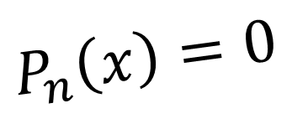
CH2120 Polynomial Equations
$$P_{n}\left(x\right)=0$$
Class 20
September 26, 2022

Slide 2

Polynomial Equation
$$P_{n}\left(x\right)=0$$
$$P_{n}\left(x\right)={a_{0}x}^{n}+a_{1}x^{n−1}+a_{2}x^{n−2}+…+a_{n−2}x^{2}+a_{n−1}x+a_{n}$$
a’s: real constants
The Newton-Raphson Method
Roots: n

Slide 3
The Newton-Raphson Method

Slide 4

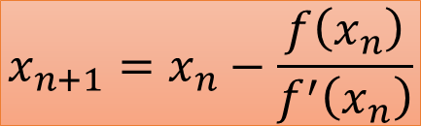
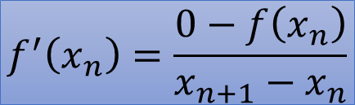


The Newton-Raphson Method
$$m=f^{′}\left(x_{n}\right)$$
$$\left(x_{n},f\left(x_{n}\right)\right)$$
$$\left(x_{n+1},0\right)$$
$$f^{′}\left(x_{n}\right)=\frac{0−f\left(x_{n}\right)}{x_{n+1}−x_{n}}$$
$$x_{n+1}=x_{n}−\frac{f\left(x_{n}\right)}{f^{′}\left(x_{n}\right)}$$

Slide 5
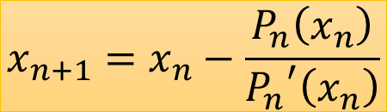
Polynomial Equation
$$x_{n+1}=x_{n}−\frac{P_{n}\left(x_{n}\right)}{{P_{n}}^{′}\left(x_{n}\right)}$$
No. of calculations…?
$$P_{n}\left(x\right)=0$$
$$P_{n}\left(x\right)={a_{0}x}^{n}+a_{1}x^{n−1}+a_{2}x^{n−2}+…+a_{n−2}x^{2}+a_{n−1}x+a_{n}$$
The Newton-Raphson Method

Slide 6




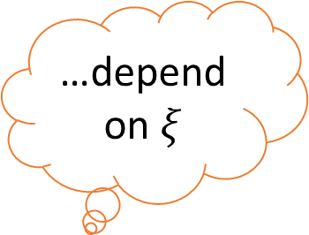




Polynomial Equation
$$x_{n+1}=x_{n}−\frac{P_{n}\left(x_{n}\right)}{{P_{n}}^{′}\left(x_{n}\right)}$$
…depend on $ξ$
$$P_{n}\left(x\right)=0$$
$$P_{n}\left(x\right)=x^{n}+a_{1}x^{n−1}+a_{2}x^{n−2}+…+a_{n−2}x^{2}+a_{n−1}x+a_{n}$$
$$P_{n}\left(x\right)=\left(x−ξ\right)Q_{n−1}\left(x\right)+R$$
$$x^{3}−7x+9=\left(x−1\right)\left(x^{2}+x−6\right)+3$$
$$P_{3}\left(x\right)$$
$$ξ=1$$
$$Q_{2}\left(x\right)$$
$$R=3$$
$$R=0$$
$$root=ξ$$

Slide 7
Polynomial Equation
$$x_{n+1}=x_{n}−\frac{P_{n}\left(x_{n}\right)}{{P_{n}}^{′}\left(x_{n}\right)}$$
$$P_{n}\left(x\right)=0$$
$$P_{n}\left(x\right)=x^{n}+a_{1}x^{n−1}+a_{2}x^{n−2}+…+a_{n−2}x^{2}+a_{n−1}x+a_{n}$$
$$P_{n}\left(x\right)=\left(x−ξ\right)Q_{n−1}\left(x\right)+R$$
$$Q_{n−1}\left(x\right)=x^{n−1}+b_{1}x^{n−2}+b_{2}x^{n−3}+…+b_{n−2}x+b_{n−1}$$
$$x^{n}+a_{1}x^{n−1}+a_{2}x^{n−2}+…+a_{n−2}x^{2}+a_{n−1}x+a_{n}$$
$$=\left(x−ξ\right)\left[x^{n−1}+b_{1}x^{n−2}+b_{2}x^{n−3}+…+b_{n−2}x+b_{n−1}\right]+R$$

Slide 8

Polynomial Equation
$$x_{n+1}=x_{n}−\frac{P_{n}\left(x_{n}\right)}{{P_{n}}^{′}\left(x_{n}\right)}$$
$$x^{n}+a_{1}x^{n−1}+a_{2}x^{n−2}+…+a_{n−2}x^{2}+a_{n−1}x+a_{n}$$
$$=\left(x−ξ\right)\left[x^{n−1}+b_{1}x^{n−2}+b_{2}x^{n−3}+…+b_{n−2}x+b_{n−1}\right]+R$$
$$=x\left[x^{n−1}+b_{1}x^{n−2}+b_{2}x^{n−3}+…+b_{n−2}x+b_{n−1}\right]$$
$$−ξ\left[x^{n−1}+b_{1}x^{n−2}+b_{2}x^{n−3}+…+b_{n−2}x+b_{n−1}\right]+R$$
$$=x^{n}+\left(b_{1}−ξ\right)x^{n−1}+\left(b_{2}−b_{1}ξ\right)x^{n−2}+…+\left(b_{n−2}−b_{n−3}ξ\right)x^{2}$$
$$+\left(b_{n−1}−b_{n−2}ξ\right)x+\left(R−b_{n−1}ξ\right)$$

Slide 9


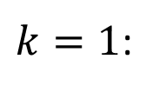






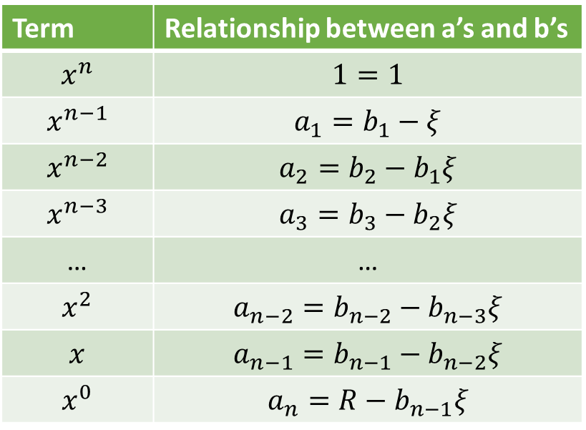



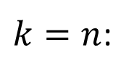


Polynomial Equation
$$x_{n+1}=x_{n}−\frac{P_{n}\left(x_{n}\right)}{{P_{n}}^{′}\left(x_{n}\right)}$$
$$x^{n}+a_{1}x^{n−1}+a_{2}x^{n−2}+…+a_{n−2}x^{2}+a_{n−1}x+a_{n}$$
$$P_{n}\left(x\right)=0$$
$$=x^{n}+\left(b_{1}−ξ\right)x^{n−1}+\left(b_{2}−b_{1}ξ\right)x^{n−2}+…+\left(b_{n−2}−b_{n−3}ξ\right)x^{2}$$
$$+\left(b_{n−1}−b_{n−2}ξ\right)x+\left(R−b_{n−1}ξ\right)$$
Term | Relationship between a’s and b’s
$$x^{n}$$ | $$1=1$$
$$x^{n−1}$$ | $$a_{1}=b_{1}−ξ$$
$$x^{n−2}$$ | $$a_{2}=b_{2}−b_{1}ξ$$
$$x^{n−3}$$ | $$a_{3}=b_{3}−b_{2}ξ$$
… | …
$$x^{2}$$ | $$a_{n−2}=b_{n−2}−b_{n−3}ξ$$
$$x$$ | $$a_{n−1}=b_{n−1}−b_{n−2}ξ$$
$$x^{0}$$ | $$a_{n}=R−b_{n−1}ξ$$
$$a_{k}=b_{k}−b_{k−1}ξ$$
$$…k=1, 2, …, n$$
$k=1$:
$$a_{1}=b_{1}−b_{0}ξ$$
$$b_{0}=1$$
$k=n$:
$$a_{n}=b_{n}−b_{n−1}ξ$$
$$b_{n}=R$$
$$b_{k}=a_{k}+ξb_{k−1}$$
$$…k=1, 2, …, n$$
…Q and R from P and $ξ$

Slide 10



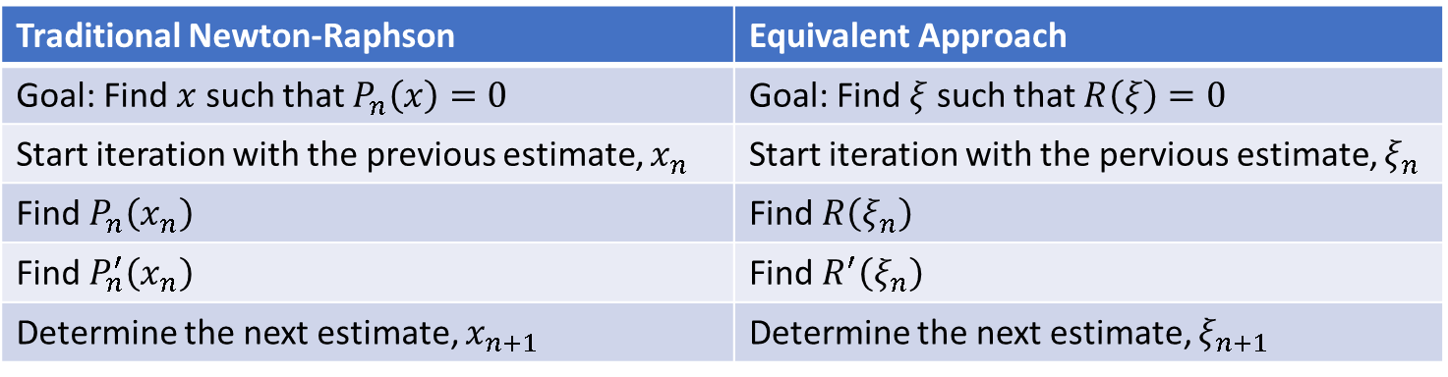







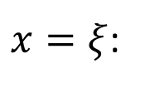

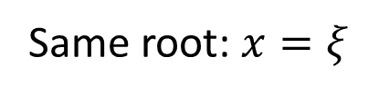
Evaluating R and R’ is less expensive!
Same root: $x=ξ$
$$P_{n}\left(x\right)=\left(x−ξ\right)Q_{n−1}\left(x\right)+R=0$$
$$b_{k}=a_{k}+ξb_{k−1}$$
$$…k=1, 2, …, n$$
If $ξ$ is the exact root…
$x=ξ$:
$$b_{0}=1$$
$$P_{n}\left(ξ\right)=\left(ξ−ξ\right)Q_{n−1}\left(ξ\right)+R=0$$
$$R\left(ξ\right)=0$$
$$b_{n}=R$$
Traditional Newton-Raphson | Equivalent Approach
Goal: Find $x$ such that $P_{n}\left(x\right)=0$ | Goal: Find $ξ$ such that $R\left(ξ\right)=0$
Start iteration with the previous estimate, $x_{n}$ | Start iteration with the pervious estimate, $ξ_{n}$
Find $P_{n}\left(x_{n}\right)$ | Find $R\left(ξ_{n}\right)$
Find $P_{n}^{′}\left(x_{n}\right)$ | Find $R^{′}\left(ξ_{n}\right)$
Determine the next estimate, $x_{n+1}$ | Determine the next estimate, $ξ_{n+1}$
$$x_{n+1}=x_{n}−\frac{P_{n}\left(x_{n}\right)}{{P_{n}}^{′}\left(x_{n}\right)}$$
$$ξ_{n+1}=ξ_{n}−\frac{R\left(ξ\right)}{R^{′}\left(ξ\right)}$$
Update $ξ$ in each iteration till $R\left(ξ\right)=0$

Slide 11
CH2120 Polynomial Equations
$$P_{n}\left(x\right)=0$$
Class 21
September 28, 2022

Slide 12

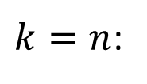

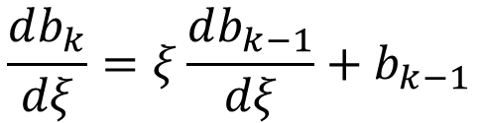
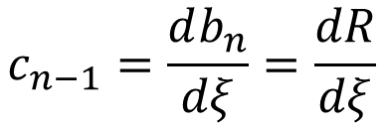


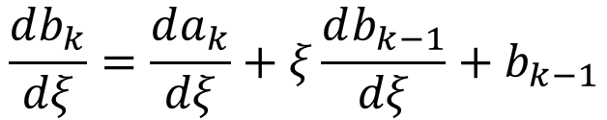
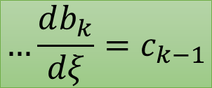

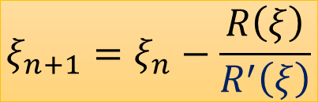




R’
…depend on $ξ$
$$c_{k−1}=\frac{db_{k}}{dξ}$$
$k=n$:
$$b_{k}=a_{k}+ξb_{k−1}$$
$$…k=1, 2, …, n$$
Q and R
$$b_{0}=1$$
$$c_{n−1}=\frac{db_{n}}{dξ}=\frac{dR}{dξ}$$
$$b_{n}=R$$
$$ξ_{n+1}=ξ_{n}−\frac{R\left(ξ\right)}{R^{′}\left(ξ\right)}$$
$$\frac{db_{k}}{dξ}=\frac{da_{k}}{dξ}+ξ\frac{db_{k−1}}{dξ}+b_{k−1}$$
$$\frac{db_{k}}{dξ}=ξ\frac{db_{k−1}}{dξ}+b_{k−1}$$
$$c_{k−1}=ξc_{k−2}+b_{k−1}$$
$$c_{k}=ξc_{k−1}+b_{k}$$
$$…\frac{db_{k}}{dξ}=c_{k−1}$$
$$…k=1, 2, …, n−1$$

Slide 13




















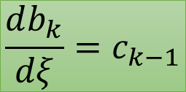











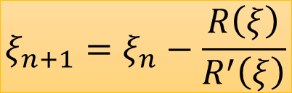









Summary of a’s, b’s, and c’s
$$P_{n}\left(x\right)=0$$
$$P_{n}\left(x\right)=\left(x−ξ\right)Q_{n−1}\left(x\right)+R$$
$$ξ_{n+1}=ξ_{n}−\frac{R\left(ξ\right)}{R^{′}\left(ξ\right)}$$
$$1$$
$$a_{0}$$
$$a_{1}$$
$$a_{2}$$
$$a_{3}$$
$$a_{4}$$
$$…$$
$$a_{n−2}$$
$$a_{n−1}$$
$$a_{n}$$
$$P_{n}\left(x\right)$$
$$P_{n}\left(x\right)=x^{n}+a_{1}x^{n−1}+a_{2}x^{n−2}+…+a_{n−2}x^{2}+a_{n−1}x+a_{n}$$
$$n+1$$
$$1$$
$$R$$
$$b_{0}$$
$$b_{1}$$
$$b_{2}$$
$$b_{3}$$
$$b_{4}$$
$$…$$
$$b_{n−2}$$
$$b_{n−1}$$
$$b_{n}$$
$$n+1$$
$$Q_{n−1}\left(x\right)$$
$$Q_{n−1}\left(x\right)=x^{n−1}+b_{1}x^{n−2}+b_{2}x^{n−3}+…+b_{n−2}x+b_{n−1}$$
$$b_{k}=a_{k}+ξb_{k−1}$$
$$1$$
$$R^{′}$$
$$c_{0}$$
$$c_{1}$$
$$c_{2}$$
$$c_{3}$$
$$c_{4}$$
$$…$$
$$c_{n−2}$$
$$c_{n−1}$$
$$\frac{db_{k}}{dξ}=c_{k−1}$$
$$c_{k}=ξc_{k−1}+b_{k}$$
$$c_{−1}=\frac{db_{0}}{dξ}=\frac{d\left(1\right)}{dξ}=0$$
$$c_{0}=\frac{db_{1}}{dξ}=\frac{d\left(a_{1}+ξb_{0}\right)}{dξ}=\frac{d\left(a_{1}+ξ\right)}{dξ}=\frac{d\left(a_{1}\right)}{dξ}+\frac{d\left(ξ\right)}{dξ}=1$$

Slide 14





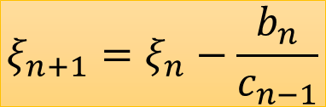
Newton-Raphson Iterations
Previous
Find all b’s using
Find all c’s using
Find new using
$$ξ$$
$$b_{k}=a_{k}+ξb_{k−1}$$
$$c_{k}=ξc_{k−1}+b_{k}$$
Error > Tolerance
$$ξ$$
$$ξ_{n+1}=ξ_{n}−\frac{b_{n}}{c_{n−1}}$$
Repeat for $n$ roots

